Slide 1
NPTEL
Video Course on Machine Learning
Professor Carl Gustaf Jansson, KTH
Week 6 Machine Learning based
on Artificial Neural Networks
Video 6.4 Learning in a Feed Forward
Multi Layer ANN: Backpropagation

Slide 2
Structure of Lectures in week 6
L1 Fundamentals of
Neural Networks
McCulloch and Pitts
Supervised learning L2 Perceptrons Linear L6 Hebbian Learning and
- classification classification Associative Memory
- regression
L3 och L4 Feed forward multiple layer Reinforcement
networks and Backpropagation learning Unsupervised learning
We are here now
L5 Recurrent Neural Sequence and L7 Hopfield Networks and
Perception Networks (RNN) temporal data Boltzman Machines
L8 Convolutional Neural
Networks (CNN)
L9 Deep Learning and
recent developments
Development of
the ANN field
L10 Tutorial on assignments

Slide 3
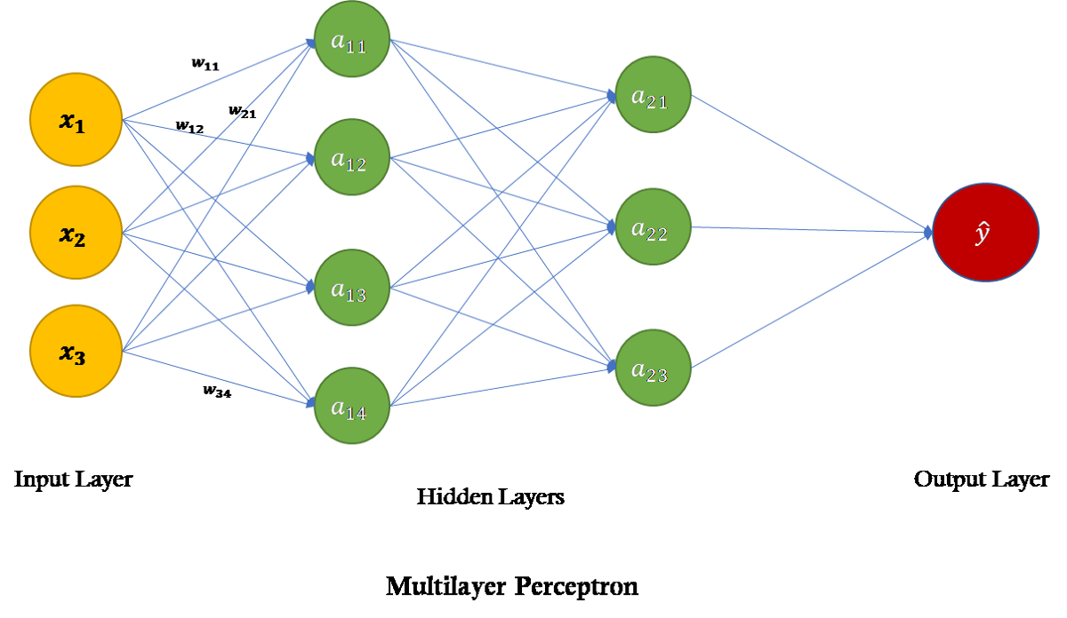
Learning in a Feed Forward
Multi Layer ANN: Backpropagation
This lecture will focus on the feed forward multi layer network case with a learning mechanism called Backpropagation
Terminologies are somewhat confusing as sometimes a single layer ANN is called a Perceptron and sometimes a multi layer ANN is called a multi layer perceptron (MLP).
Backpropagation is a generalization of the delta learning rule for single neurons. Backpropagation is shorthand for "the backward propagation of errors," since an error is computed at the output and distributed backwards throughout the network’s layers.
Backpropagation is based on the chain rule to iteratively compute the gradients for each layer needed in the calculation of the updates of the weights for these layers. Backpropagation is a special case of a more general technique called automatic differentiation.

Slide 4
Automatic Differentiation
Automatic differentiation (AD), also called algorithmic differentiation or computational differentiation, is a set of techniques to numerically evaluate the derivative of a function specified by a computer program.
AD exploits the fact that every computer program, no matter how complicated, executes a sequence of elementary arithmetic operations (addition, subtraction, multiplication, division, etc.) and elementary functions (exp, log, sin, cos, etc.).
By applying the chain rule repeatedly to these operations, derivatives of arbitrary order can be computed automatically, accurately and efficiently.

Slide 5
The combined Feed Forward and Backpropagation mechanisms
0.1. Specify the structure of the multiple layer ANN, incuding inputs and outputs.
0.2. Specify the biases (modelled as extra inputs) and activation functions for all neurons
0.3 Specify the learning rate
For each data item (input and output vector)
Feed forward the input values across the network using the Single Neuron model for each neuron
to calculate the output values in all layers
If Sum wij * xi > 0 the output of unit j Yj is calculated as = f ( Sum (wij * xi) ) otherwise Y=0
i=0..n
2. Calculate the error sensitivity at the output node dj = (Tj– Yj) * d f(e)/de
Backpropagate the errors across the network using the same weights as for the feed forward phase:
di = Sum (wij * dj)
j= all outputs of i
4. Update the weights using the backpropagation weight updating formula: wij = wij + ( a * dj * dFj(e)/de * xi)
j=all outputs, a =learning rate, xi =input i,
e=weighted input sum in j, F = activation function for j

Slide 6
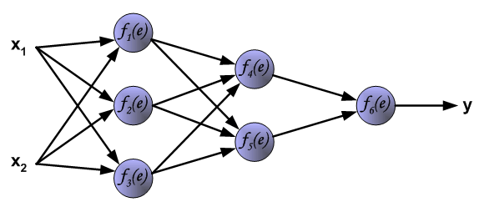
Example of feed forward multiple layer network
The intention with this example is primarily to exemplify the cycles including feed forward of signals, backpropagation of errors and adaption of weights.
DISCLAIMER: In the example, the neuron functionality is very simplified and partly unrealistic in the following senses:
The activation function is the identity function which means that the gradients become trivially = 1
The learning rate = 1
The bias are disconsidered to simplify the graphs (but could be easily included as shown in the single neuron lecture.
This neural network has two inputs, one output and 6 other units in three layers.

Slide 7
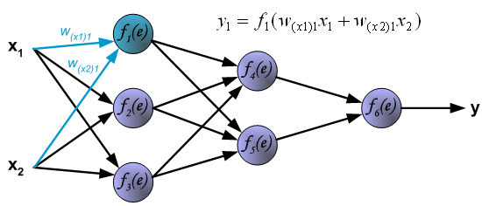
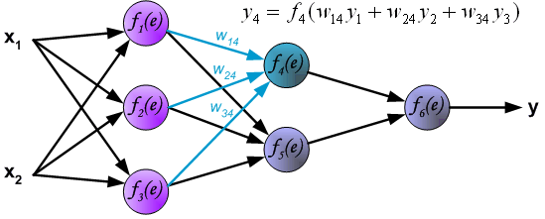
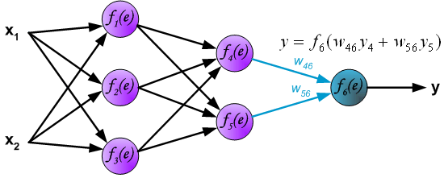
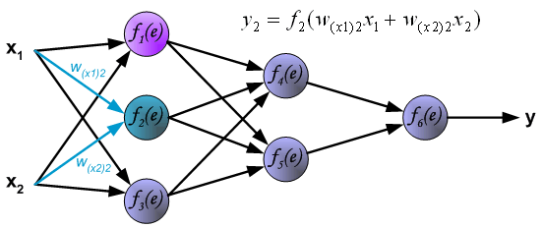
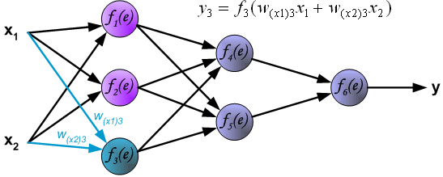
Feed forward from input to output layer

Slide 8
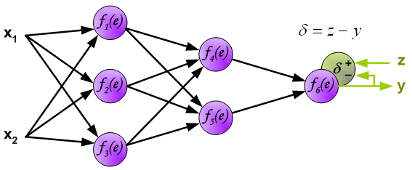
Error estimation
The output signal of the network Y is compared with the desired target value T . The difference d is termed the error sensitivity signalled from the output layer neuron.
T-Y
T

Slide 9
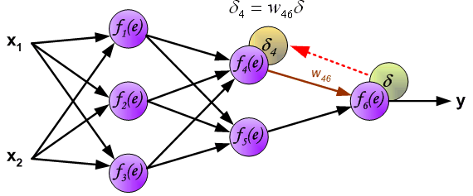
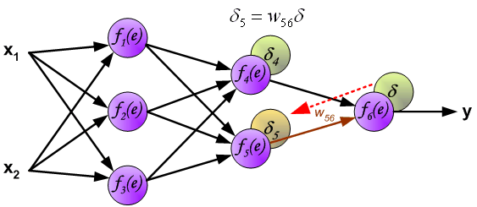
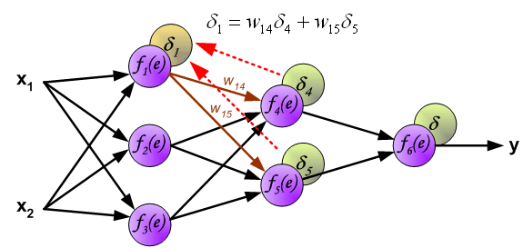
Backpropagation of errors
The error sensitivity d is propagated back from the output layer to all neurons in the preceding layer, the output signals of which were input to the considered output neuron.
However the errors of the preceding layer neurons are calculated by applying exactly the same weights as were used in the forward feeding phase.
The same procedure is applied on all boundaries between layers, back to the input layer.

Slide 10
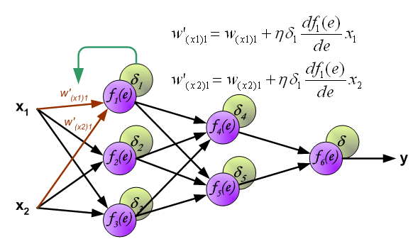
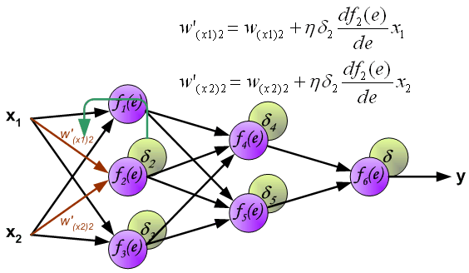
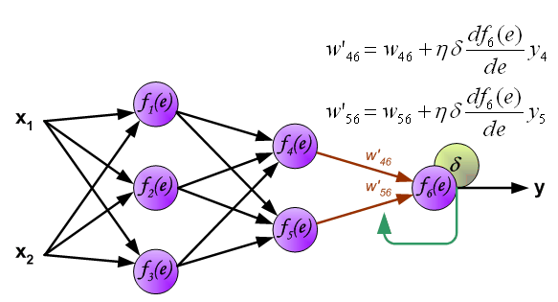
Re-calculation of weights
When the error signal for each neuron have been computed, the weights coefficients of each neuron input node can be modified.
In formulas below df(e)/de represents the derivative of neuron activation functions.

Slide 11
Example: Feed forward from input to output layer + error estimate
Bias=0
Learning rate= 1
Activation function = identity function
y=1.5
11
1
0.5
y = sum xi*wi in all steps
i
0.5
y=2.25
0.5
X1=1
4
y=1.5
0.5
0.5
y=2.25
0.5
2
0.5
6
Y=2.25, Z=3
D=0.75
y=2.25
0.5
0.5
0.5
0.5
5
X2=2
0.5
0.5
0.5
3
y=1.5

Slide 12
Example: Backpropagation of error
Bias=0
Learning rate= 1
Activation function = identity function
D1 =0.5*0.375+0.5*0.375=0.375
1111
1
0.5
0.5
0.5
D4 =0.5*0.75=0.375
X1=1
0.5
4
D2 =0.375
0.5
Z=3
Y=2.25
D=0.75
0.5
2
0.5
6
0.5
0.5
0.5
0.5
5
X2=2
D5 =0.5*0.75=0.375
0.5
0.5
0.5
3
D3 =0.5*0.375+0.5*0.375=0.375

Slide 13
Example: Re-calculation of weights
Bias=0
Learning rate= 1
Activation function = identity function
y=1.5
D1 =0.375
1111
0.5
1
W´=0.5+1.5*0.375=1.055
W´=0.5+1*0.375=0.875
0.5
0.5
D4 =0.375
X1=1
0.5
y=2.25
W´=1.25
4
W´= ?
D2 =0.375
0.5
W´=0.875
0.5
2
y=1.5
W´=1.055
0.5
6
Z=3
Y=2.25
D=0.75
W´=1.25
0.5
0.5
0.5
0.5
W´= ?
W´=0.875
5
X2=2
D5 =0.375
0.5
0.5
y=2.25
W´=0.5+2*0.375=1.25
3
W´=0.5+1.5*0.375=1.055
0.5
D3 =0.375
y=1.5

Slide 14
An Analogy to Backpropagation in ANN
Bucket Brigade Algorithm
for Genetic Algorithms/Classifier systems
A classifier system is a rule-based system architecture where the adaption of the rule-base is based on a genetic algorithm architecture.
In the genetic algorithm terminology a rule is considered as a gene in the gene pool and is thereby automatically provided with a fitness value. The fitness of a rule decides its destiny in the genetic selection process.
In the fashion of re-inforcement learning the outcome of each problemsolving session is provided with a reward (can be compared to an ANN error value).
Many rules contribute to each solution (typically in a hierachical fashion). The Bucket Brigade Algorithm allocates credit and blame backwards in the rule application hierarchy
and the alotted award for a particular rule forms the basis for updating its fitness value.

Slide 15
Specific Feed Forward approaches

Slide 16
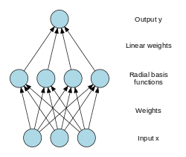
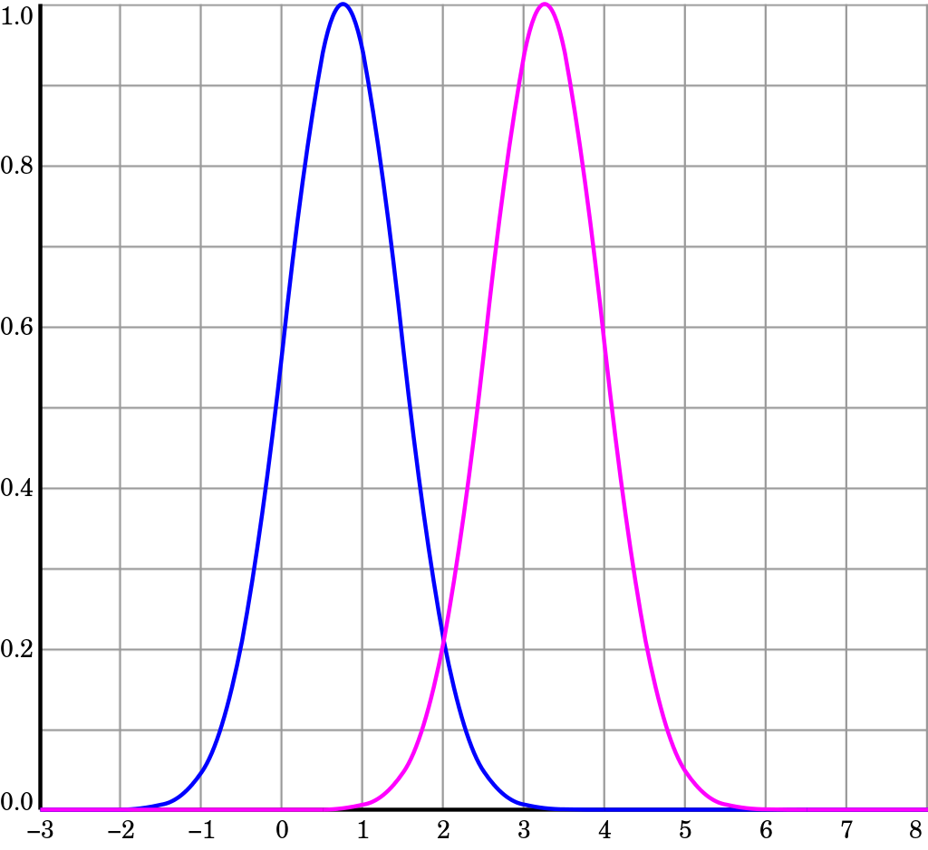
Radial Basis Function Network
The basic architecture for a RBF is a 3-layer network.
The input layer is simply a fan-out layer and does no processing. The second or hidden layer performs a non-linear mapping from the input space into a (usually) higher dimensional space in which the patterns become linearly separable.
The final layer performs a simple weighted sum with a linear output as needed for Regression.
However, if pattern classification is required, then a hard-limiter or sigmoid function could be placed on the output neurons to give 0/1 output values.

Slide 17
Autoencoder
An Autoencoder is a feedforward, non-recurrent neural network which can perform unsupervised learning.
An Autoencoder is a multilayer perceptron (MLP) having an input layer, an output layer and one or more hidden layers connecting them but with the output layer having the same number of nodes as the input layer.
The aim of an Autoencoder is to learn a representation (encoding) for a set of data, typically for dimensionality reduction, by training the network to ignore signal noise.
In addition to reduction an Autoencoder can also be used for reconstruction, where the it tries to generate from the reduced encoding a representation as close as possible to its original input, hence its name.

Slide 18
NPTEL
Video Course on Machine Learning
Professor Carl Gustaf Jansson, KTH
Thanks for your attention!
The next lecture 6.5 will be on the topic:
Recurrent Neural Networks

